Slide 1
Standard Template Library
CS 201, Summer 2013

Slide 2
ADDITIONAL READING
STL Reference
  Chapter 7.3, 19 of the Pearson book
  http://www.cplusplus.com/reference/
  http://www.cplusplus.com/reference/stl/
Iterators
  http://www.cs.northwestern.edu/~riesbeck/programming/c++/stl-iterators.html
  http://www.cprogramming.com/tutorial/stl/iterators.html
  http://www.cplusplus.com/reference/iterator/iterator/

Slide 3
Standard Template Library
Vectors and Iterators
List
Stack
Queue
Map and Set

Slide 4
Vectors
Vectors are essentially like a template class that stores an array.
The Vector class will handle resizing automatically for you.
You can access elements of the Vector just like with an array (with the Subscript operator).
The Vector class has additional functions like size, erase, clear, and more.

Slide 5
Vectors
In order to use vector, we need to include the vector library.
vector is a template class, so we can use any data-type

Slide 6

Vectors
To add an item to the vector, we use the push_back function.
The index begins at 0 and increments.
Here, item #0 is 2, and item #1 is 4.

Slide 7

Vectors
We can access specific elements of the vector with the subscript operator.
We can also use the .size() function to get the amount of elements in the vector

Slide 8
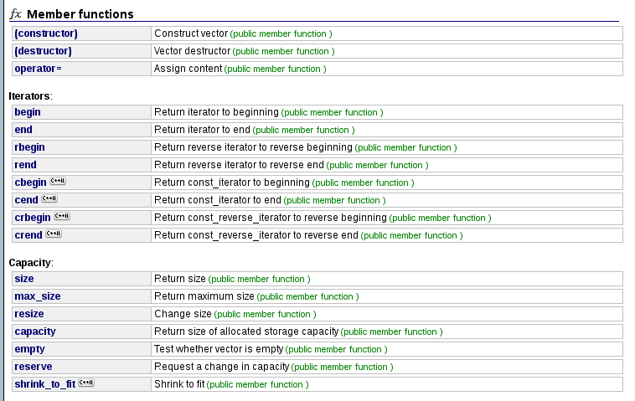
Vectors
You can view a list and examples of all of vector's functionality at
http://www.cplusplus.com/reference/vector/vector/

Slide 9
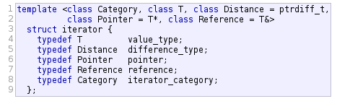
Iterators
C++ does not have “for each” loops like Python, Java, and C#.
We can use Iterators in a similar way.
An iterator is a struct in the C++ Standard Lib
(Image from cplusplus.com)

Slide 10
Iterators
Iterators aren't pointers, but behave like pointers.
An iterator will “point” to an element within an STL Container class (e.g., vector)
We can move the iterator up and down the list of items within that container with ++ and - -.

Slide 11
Iterators
Iterators aren't pointers, but behave like pointers.
An iterator will “point” to an element within an STL Container class (e.g., vector)
We can move the iterator up and down the list of items within that container with ++ and - -.

Slide 12
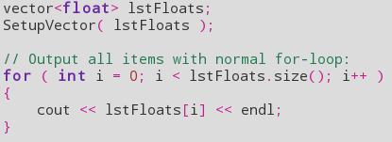
Iterators
We could iterate through a vector with a standard for-loop, from 0 to the size of the vector.
This may not work for containers that don't let you access elements directly with subscript [ ].

Slide 13
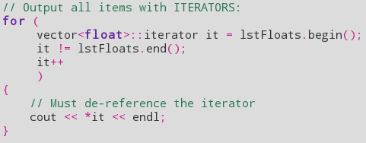
Iterators
Or we could use iterators, which traverse the vector.
Uglier, but sometimes useful.

Slide 14
Iterators
This is structured just like a normal for-loop: Three separate statements, separated by semi-colons.

Slide 15
Iterators
For the initialization statement, we have:
vector<float>::iterator it = lstFloats.begin();
We are declaring an iterator named “it”. The iterator “type” is vector<float>::iterator
Each STL container has an iterator type.

Slide 16
Iterators
We assign “it” equal to lstFloats.begin().
The begin() function returns an iterator pointing to the first element in our vector.

Slide 17
Iterators
The second statement is the looping condition – This loop will continue while the second statement is true.
Here, we want to loop while our iterator “it” is not at the end of our vector.
The end() function returns an iterator pointing to after the last element in the vector.

Slide 18
Iterators
Lastly, every time through the loop we use the increment operator on our iterator.

Slide 19
Iterators
Then, we can access this element by de-referencing the iterator.
If the iterator is pointing to a class, we can also use the arrow operator -> to access members.

Slide 20
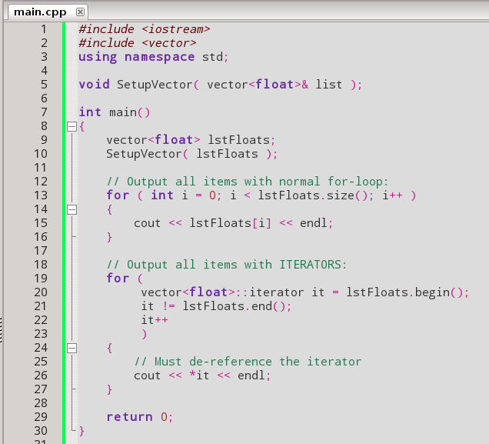
Iterators

Slide 21
List
Lists are similar to Vectors but are implemented differently behind-the-scenes.
The STL List is a doubly-linked-list, where each element of the list points to the element immediately ahead of and behind itself.
You can use both push_back and push_front to insert elements.

Slide 22
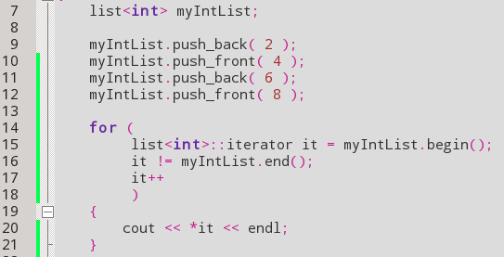
List
Cannot use operator [ ] to access any element
Need to traverse the list via Iterators instead.

Slide 23
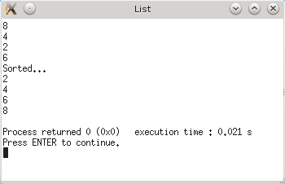
List
Can also use sort() to sort the list...

Slide 24
Stack
A Stack data-structure is a “First-In-Last-Out” (or “Last-In-First-Out”) structure...
The first item inserted goes on the bottom, and each additional item goes above it.
Then, we can only pull off the top-most element, and we cannot access the first element until everything above it is gone.
6
5
4
3
2
1

Slide 25
Stack
To add something to the stack, you use push.
To remove the top item from the stack, you use pop.
If you just want the value of the top element without removing it, you use top.
Otherwise, you can use size to get the element size and empty to clear it out.
10
9
8
7
6
5
4
3
2
1

Slide 26
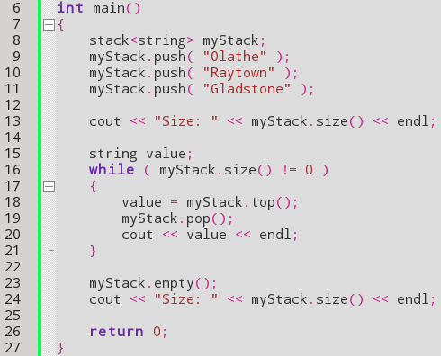
Stack
Pushing new values
Checking the size
Getting the top value
Removing the top value

Slide 27
Queue
A Queue data-structure is a “First-In-First-Out” data structure, similar to people queueing up in a line at the DMV (woo...)
The first item gets inserted at the bottom, and we can continue adding items after the first one.
When we pull a value off the queue, we get the first element in the list first.
6
5
4
3
2
1

Slide 28
Queue
To add something to the queue, you use push.
To remove the top item from the queue, you use pop.
If you just want the value of the first element without removing it, you use front.
Otherwise, you can use size to get the element size and empty to clear it out.
10
9
8
7
6
5
4
3
2
1

Slide 29
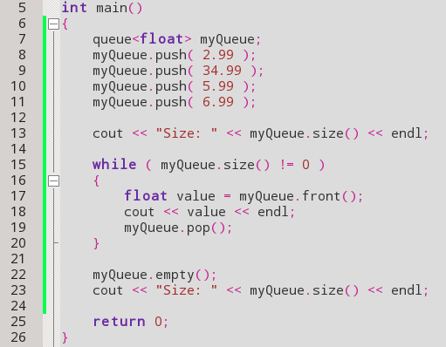
Queue
Push values to the queue
Get the queue size
Get front value
Remove front value

Slide 30
Map and Pair
The Map container is similar to the Dictionary object in Python.
You can have a key-value pair.
For example:
  ID Number and User Name
  Last Name and Family Size
  Day and Event

Slide 31
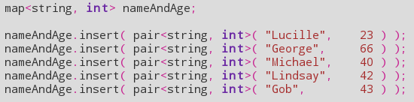
Map and Pair
The key is used to look up the value.
With map, you can use insert to add a new value.
  With the insert function, you need to pass in a pair object as the parameter.

Slide 32
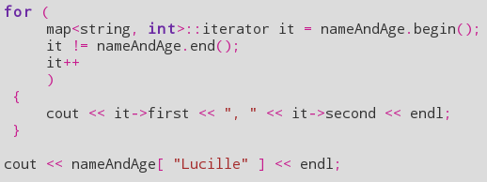
Map and Pair
You will also use iterators to parse through the Map object.
You can also access elements via the subscript operator [ ]

Slide 33
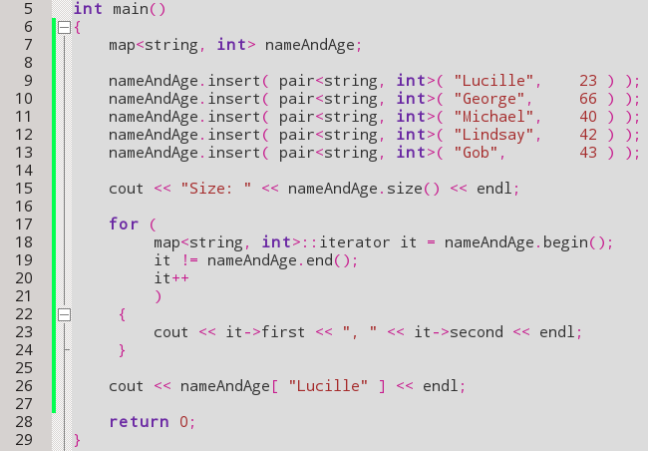
Map and Pair
Inserting an item to the map requires passing in a pair.
Here, the key is a string and the value is an int.
To access a key, we use first, and to access the value we use second.
We can also use the subscript operator with the appropriate key to access a value.

Slide 34
References
Std::iterator
CplusPlus.com
http://www.cplusplus.com/reference/iterator/iterator/

